Slide 1
IT Hub Company Ltd.
Building a Secure and Efficient Network

Slide 2
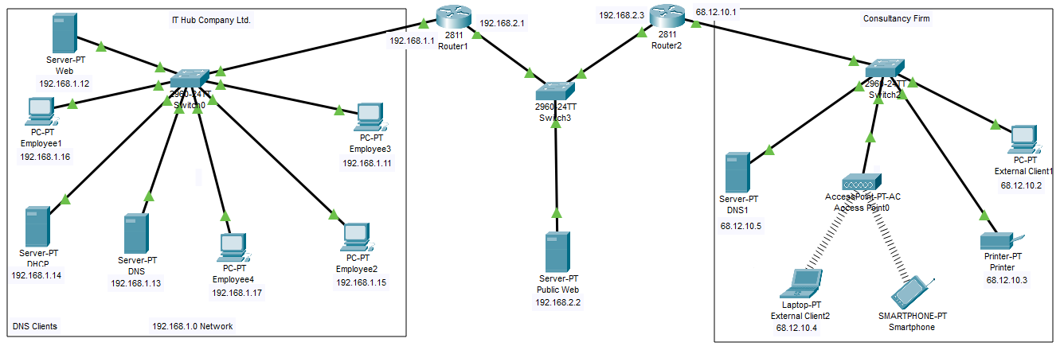
Network Design Layout

Slide 3
Internal Network
The internal network is the network that is accessed within the company.
A router is used as the connection point and has the default gateway.
A switch is used as a connection point for the many devices to the router.
The network contains three servers, used for DHCP, DNS, and the Internal Website, respectively.
Four PCs are connected with a wire to the switch.

Slide 4
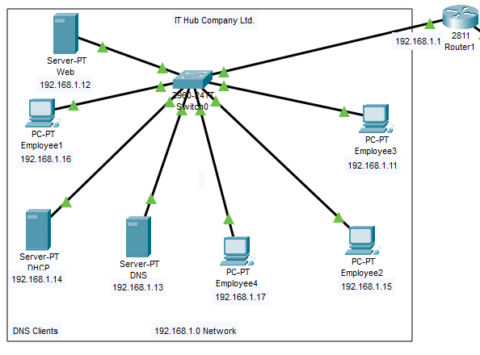
Internal Network Layout

Slide 5
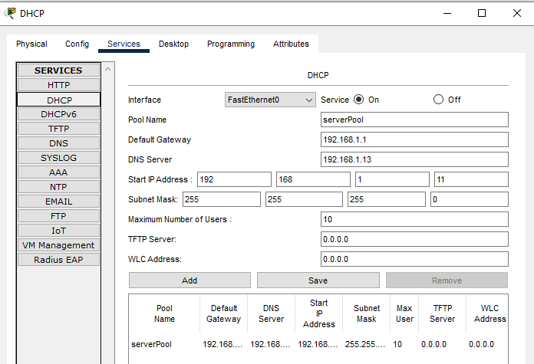
GHCP Servers
One server is configured to be the DHCP server and automatically assigns devices IP addresses. The DHCP server used a static IP address of 192.168.1.14. Depicted IP address starts from 192.168.1.11. IP addresses within the 192.168.1.11 and 192.168.1.20 range are used for static IPs on devices to ensure they do not change.

Slide 6
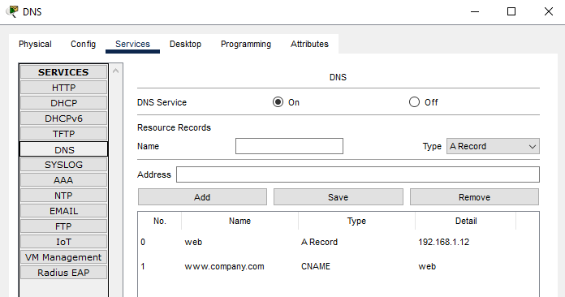
DNS Servers
Second server is used as the DNS server and its static IP address is set to 192.168.1.13. It provides what IPs are used for websites & illustrates the addresses used to connect on an internet browser.

Slide 7
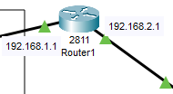
Router 1
The default gateway for the internal network is 192.168.1.1 based on Router1. The default gateway for the DMZ is also on this router with 192.168.2.1. This router also acts as a link between the company Internal Network and the DMZ. Static routing is enabled to allow traffic to pass through.

Slide 8
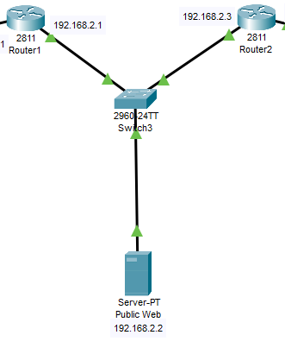
DMZ
The DMZ acts as a buffer between the company internal network and the internet. Router1 is used as the link to the internal network whereas Router2 is used as the link to the internet. The company’s public website server is contained within the DMZ.

Slide 9
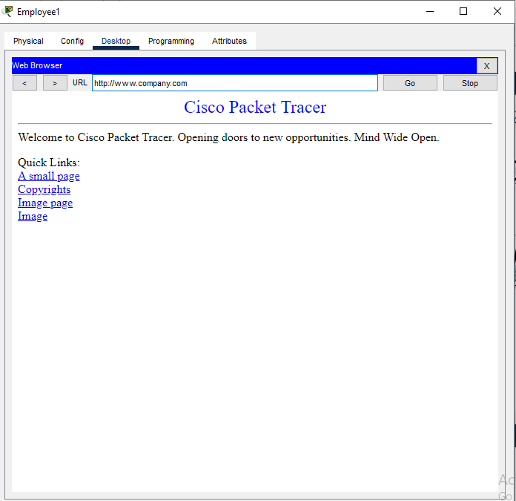
Internal Web Server
The server in the internal client is using to host the Company Website. The web server uses a static IP address of 192.168.1.12. It can be accessed with the address www.company.com with the use of DNS servers.

Slide 10
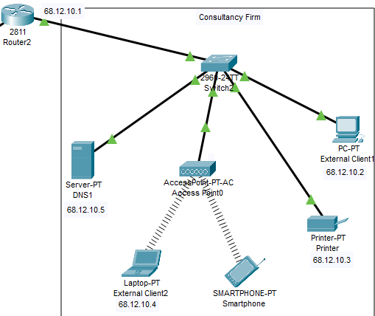
External Client Layout

Slide 11
External Client Info
The external client called as “Consultancy Firm”.
In the client, has one wired desktop, printer, access point & DNS server (68.12.10.5).
The Access Point provides wireless internet to a Laptop and a smartphone user.
Router2 acts as a link between the internet and the company networks.

Slide 12

Router2
Second router acts as a link between the company DMZ and the internet. The default gateway for the internet in this example is 68.12.10.1. Static routing is enabled to allow traffic to pass through. Port forwarding has been enabled to allow external users to be able to reach the company website.

Slide 13
Thank you for your patience

